Slide 1

Algebra 1
Unit 13, Lesson 4 Parent Functions Volume 2, pg. 253

Slide 2


Benchmark
MA.912.F.1.1
Given an equation or graph that defines a function, classify the function type. Given an input-output table, determine a function type that could represent it.
volume 2, pg. 253

Slide 3
Integrated Mathematical Thinking and Reasoning Standards
MA.K12.MTR.1.1 Actively participate in effortful learning both individually and collectively.
MA.K12.MTR.2.1 Demonstrate understanding by representing problems in multiple ways.
MA.K12.MTR.3.1 Complete tasks with mathematical fluency.
MA.K12.MTR.4.1 Engage in discussions that reflect on the mathematical thinking of self and others.
MA.K12.MTR.5.1 Use patterns and structure to help understand and connect mathematical concepts.
volume 2, pg. 253

Slide 4

Learning Targets
I can match multiple representations of the parent function to its table of values.
I can determine a function type that could represent a transformation of a parent function.
volume 2, pg. 253

Slide 5

Warm-Up
volume 2, pg. 254

Slide 6
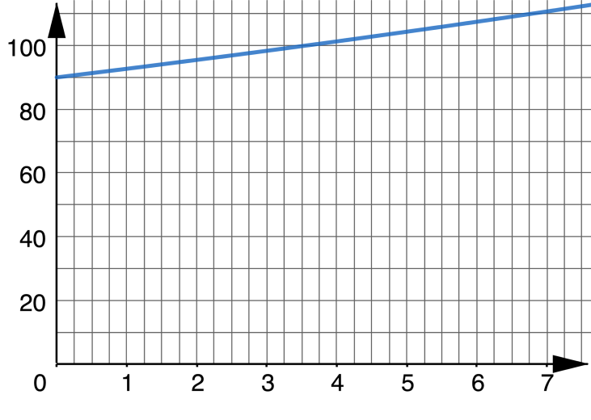
13.4.1 Warm-Up: Notice and Wonder
A graph of a function is shown.
What information might help you decide whether the graph represents a linear or an exponential function?
volume 2, pg. 254

Slide 7
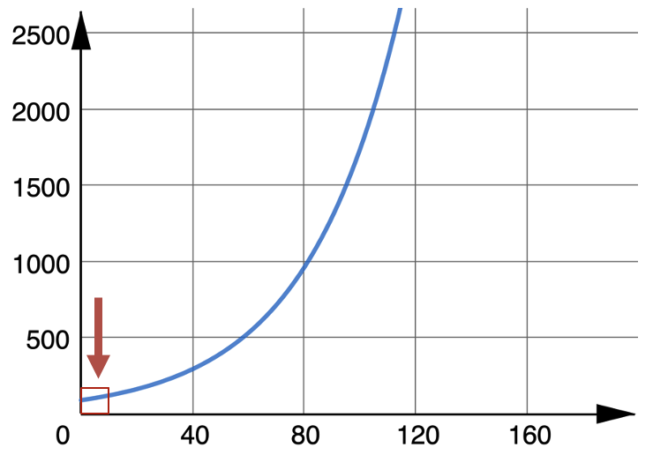

The graph of the same function is shown.
Explain why the $x$-values used for the first graph, shown in the red box, were misleading.
volume 2, pg. 254

Slide 8

Activity
volume 2, pg. 254

Slide 9

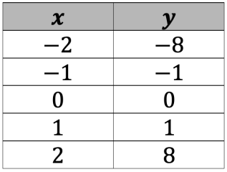
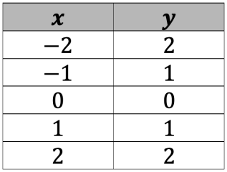
13.4.2 Activity: Parent Functions Card Sort
Sort the cards to match the equation, graph, and key features to the table of values of a parent function. Write the letter that corresponds to each in the table.
Table of Values | Equation | Graph | Key Features
volume 2, pg. 254

Slide 10
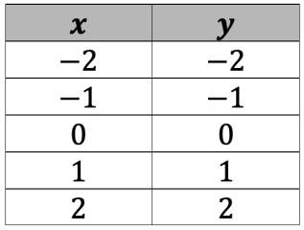
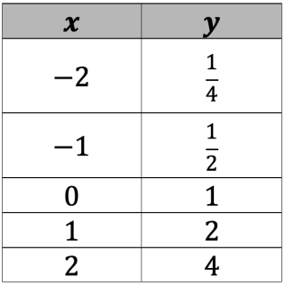
Table of Values | Equation | Graph | Key Features
volume 2, pg. 254

Slide 11
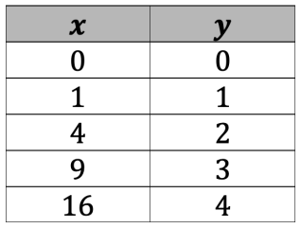
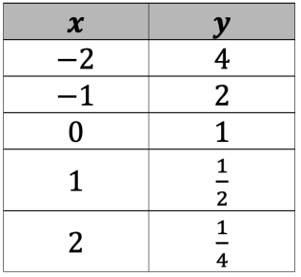
Table of Values | Equation | Graph | Key Features
volume 2, pg. 255

Slide 12
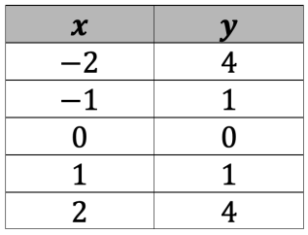
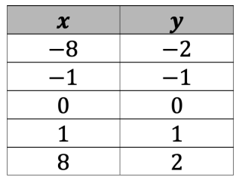
Table of Values | Equation | Graph | Key Features
volume 2, pg. 255

Slide 13

Exploration
volume 2, pg. 255

Slide 14

13.4.3 Exploration: Transformations of Parent Functions
Knowing the basic shape of a parent function helps to determine a transformation of the parent function.
Shown in the table are representations of transformations. Use the information from the card sort to help determine which family of functions each transformation is part of.
volume 2, pg. 255

Slide 15
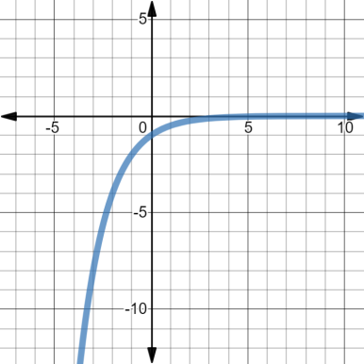
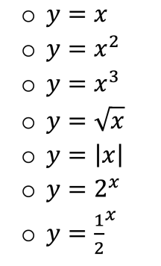
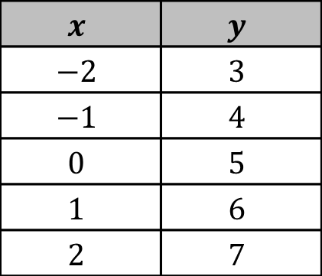
Representation of Transformation | Equation of Parent Function
$$x$$ | $$y$$
$$−2$$ | $$3$$
$$−1$$ | $$4$$
$$0$$ | $$5$$
$$1$$ | $$6$$
$$2$$ | $$7$$
volume 2, pg. 255

Slide 16
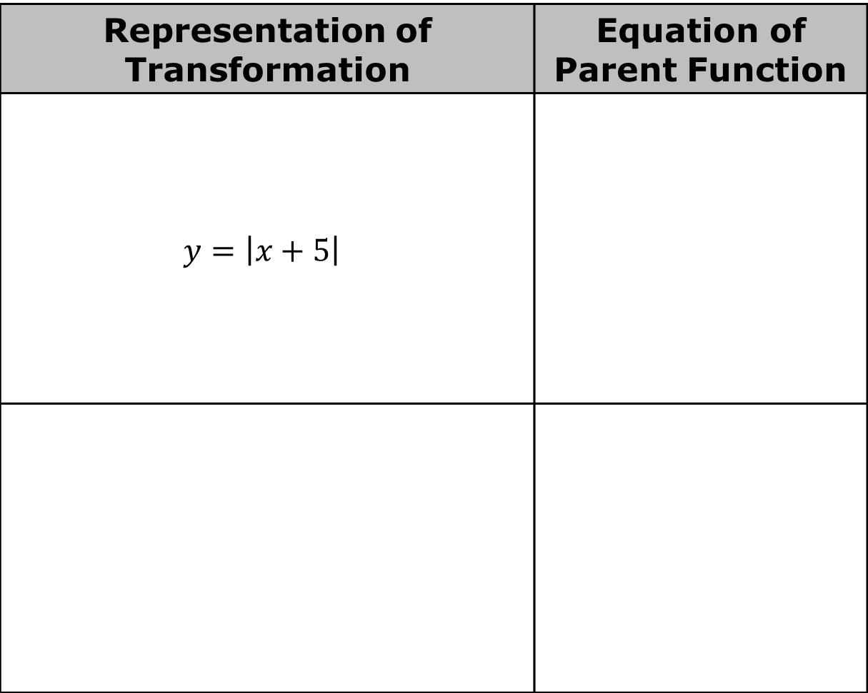
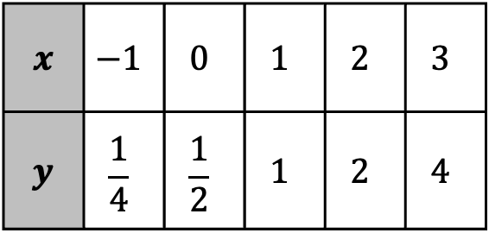
Representation of Transformation | Equation of Parent Function
$y=\left|x+5\right|$
𝒙 | $$−1$$ | $$0$$ | $$1$$ | $$2$$ | $$3$$
𝒚 | $$\frac{1}{4}$$ | $$\frac{1}{2}$$ | $$1$$ | $$2$$ | $$4$$
volume 2, pg. 256

Slide 17
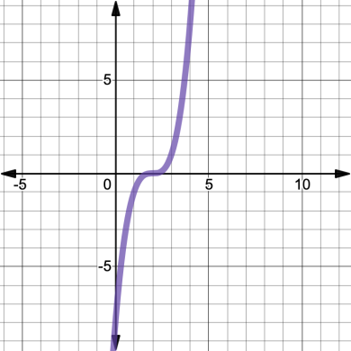
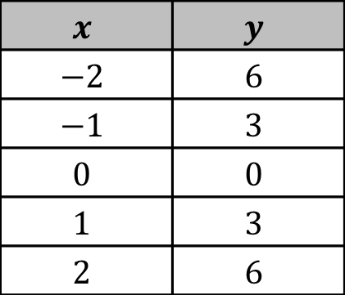
Representation of Transformation | Equation of Parent Function
$$x$$ | $$y$$
$$−2$$ | $$6$$
$$−1$$ | $$3$$
$$0$$ | $$0$$
$$1$$ | $$3$$
$$2$$ | $$6$$
volume 2, pg. 256

Slide 18
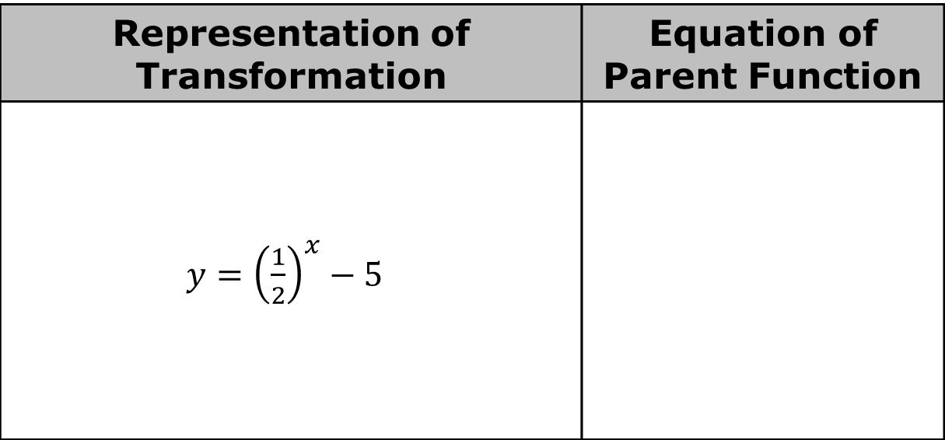
Representation of Transformation | Equation of Parent Function
$y={\left(\frac{1}{2}\right)}^{x}−5$
volume 2, pg. 256

Slide 19

Wrap-Up
volume 2, pg. 257

Slide 20
13.4.4 Wrap-Up: Reflection
Draw an X on each line to indicate how you feel about each learning target.
I can match multiple representations of the parent function to its table of values.
I need help. I can’t get started. | I’m getting there, but I need more practice. | I understand this and I feel confident.
volume 2, pg. 257

Slide 21
I can determine a function type that could represent a transformation of a parent function.
I need help. I can’t get started. | I’m getting there, but I need more practice. | I understand this and I feel confident.
volume 2, pg. 257

